Slide 1
NLP

Slide 2
Introduction to NLP
Generative vs. Discriminative Models

Slide 3
Generative vs. Discriminative Models
Generative
Discriminative
Learn a model of the joint probability p(d, c)
Use Bayes’ Rule to calculate p(c|d)
Build a model of each class; given example, return the model most likely to have generated that example
Examples: Naïve Bayes, Gaussian Discriminant Analysis, HMM, Probabilistic CFG
Model posterior probability p(c|d) directly
Class is a function of document vector
Find the exact function that minimizes classification errors on the training data
Examples: Logistic regression, Neural Networks (NNs), Support Vector Machines (SVMs), Decision Trees
Notes:
Example from Ng notes:
Discriminative: “Consider a classification problem in which we want to learn to distinguish between elephants (y = 1) and dogs (y = 0), based on some features of an animal. Given a training set, an algorithm like logistic regression or the perceptron algorithm (basically) tries to find a straight line—that is, a decision boundary—that separates the elephants and dogs. Then, to classify a new animal as either an elephant or a dog, it checks on which side of the decision boundary it falls, and makes its prediction accordingly. “
Generative: “Here’s a different approach. First, looking at elephants, we can build a model of what elephants look like. Then, looking at dogs, we can build a separate model of what dogs look like. Finally, to classify a new animal, we can match the new animal against the elephant model, and match it against the dog model, to see whether the new animal looks more like the elephants or more like the dogs we had seen in the training set.” http://cs229.stanford.edu/notes/cs229-notes2.pdf

Slide 4
Assumptions of Discriminative Classifiers
Data examples (documents) are represented as vectors of features (words, phrases, ngrams, etc)
Looking for a function that maps each vector into a class.
This function can be found by minimizing the errors on the training data (plus other various criteria)
Different classifiers vary on what the function looks like, and how they find the function

Slide 5
Discriminative vs. Generative
Discriminative classifiers are generally more effective, since they directly optimize the classification accuracy. But
They are all sensitive to the choice of features, and so far these features are extracted heuristically
Also, overfitting can happen if data is sparse
Generative classifiers are the “opposite”
They directly model text, an unnecessarily harder problem than classification
They can easily exploit unlabeled data

Slide 6
Introduction to NLP
Generative Classifier:
Naïve Bayes

Slide 7
Naïve Bayes Intuition
Simple (“naïve”) classification method based on Bayes rule
Relies on very simple representation of document
Bag of words

Slide 8
Bag of Words

Slide 9
Remember Bayes’ Rule?
Bayes’ Rule:
d is the document (represented as a list of features of a document, x₁, …, x_{n})
c is a class (e.g., “not spam”)

Slide 10
Naïve Bayes Classifier
MAP is “maximum a posteriori” = most likely class
Bayes Rule
Dropping the denominator
Notes:
We want to find the most likely class, given the document. That is, the c that maximizes P(c|d).
We apply Bayes’ Rule.
The denominator of the second line doesn’t depend on c. So the c that maximizes the second line will be exactly the same as the c that maximizes the third line. We can safely drop the denominator because we’re looking for the argmax.

Slide 11
Naïve Bayes Classifier
Document d represented as features x1..xn
But where will we get these probabilitites?

Slide 12
Naïve Bayesian Classifiers
Naïve Bayesian classifier
Assuming statistical independence
Features = words (or phrases) typically

Slide 13
Multinomial Naïve Bayes Independence Assumptions
Bag of Words assumption
Assume position doesn’t matter
Conditional Independence
Assume the feature probabilities P(x_{i}|c) are independent given the class c.
[Jurafsky and Martin]

Slide 14
Multinomial Naïve Bayes
This is why it’s naïve!
[Jurafsky and Martin]

Slide 15
Learning the Parameters
First attempt: maximum likelihood estimates
simply use the frequencies in the data
[Jurafsky and Martin]

Slide 16
Parameter Estimation
fraction of times word w_{i} appears
among all words in documents of topic c_{j}
Create mega-document for topic j by concatenating all docs in this topic
Use frequency of w in mega-document
[Jurafsky and Martin]

Slide 17
Problem with Maximum Likelihood
What if we have seen no training documents with the word fantastic and classified in the topic positive (thumbs-up)?
Zero probabilities cannot be conditioned away, no matter the other evidence!
[Jurafsky and Martin]

Slide 18
Laplace Smoothing
[Jurafsky and Martin]

Slide 19
Multinomial Naïve Bayes: Learning
From training corpus, extract Vocabulary
Calculate P(c_{j}) terms
For each c_{j} in C do
docs_{j} ← all docs with class =c_{j}
Calculate P(w_{k} | c_{j}) terms
Text_{j} ← single doc containing all docs_{j}
For each word w_{k} in Vocabulary
n_{k} ← # of occurrences of w_{k} in Text_{j}
[Jurafsky and Martin]

Slide 20


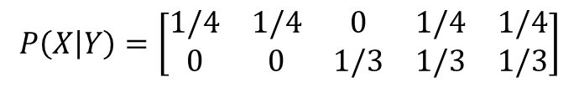

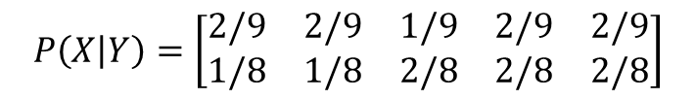
Example
$$P\left(Y\right)=\left[\begin{matrix}1/2 & 1/2\end{matrix}\right]$$
Features = {I hate love this book}
Training
I hate this book
Love this book
What is P(Y|X)?
Prior p(Y)
Testing
hate book
Different conditions
a = 0 (no smoothing)
a = 1 (smoothing)
$$M=\left[\begin{matrix}1 & 1 & 0 & 1 & 1 \\ 0 & 0 & 1 & 1 & 1\end{matrix}\right]$$
$$P\left(X | Y\right)=\left[\begin{matrix}1/4 & 1/4 & 0 & 1/4 & 1/4 \\ 0 & 0 & 1/3 & 1/3 & 1/3\end{matrix}\right]$$
$P\left(Y|X\right) ∝ \left[\begin{matrix}1/2×1/4×1/4 & 1/2×0×1/3\end{matrix}\right]$ = $\left[1 0\right]$
$$M=\left[\begin{matrix}2 & 2 & 1 & 2 & 2 \\ 1 & 1 & 2 & 2 & 2\end{matrix}\right]$$
$$P\left(X | Y\right)=\left[\begin{matrix}2/9 & 2/9 & 1/9 & 2/9 & 2/9 \\ 1/8 & 1/8 & 2/8 & 2/8 & 2/8\end{matrix}\right]$$
$P\left(Y|X\right) ∝ \left[\begin{matrix}1/2×2/9×2/9 & 1/2×1/8×2/8\end{matrix}\right]$ = $\left[0.613 0.387\right]$

Slide 21

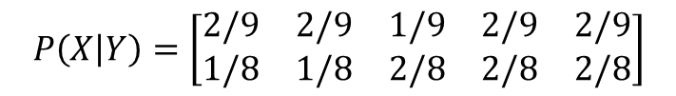
Example
$$P\left(Y\right)=\left[\begin{matrix}1/2 & 1/2\end{matrix}\right]$$
$$P\left(X | Y\right)=\left[\begin{matrix}2/9 & 2/9 & 1/9 & 2/9 & 2/9 \\ 1/8 & 1/8 & 2/8 & 2/8 & 2/8\end{matrix}\right]$$
$P\left(Y|X\right) ∝ \left[\begin{matrix}1/2×2/9×2/9 & 1/2×1/8×2/8\end{matrix}\right]$ = $\left[0.613 0.387\right]$

Slide 22
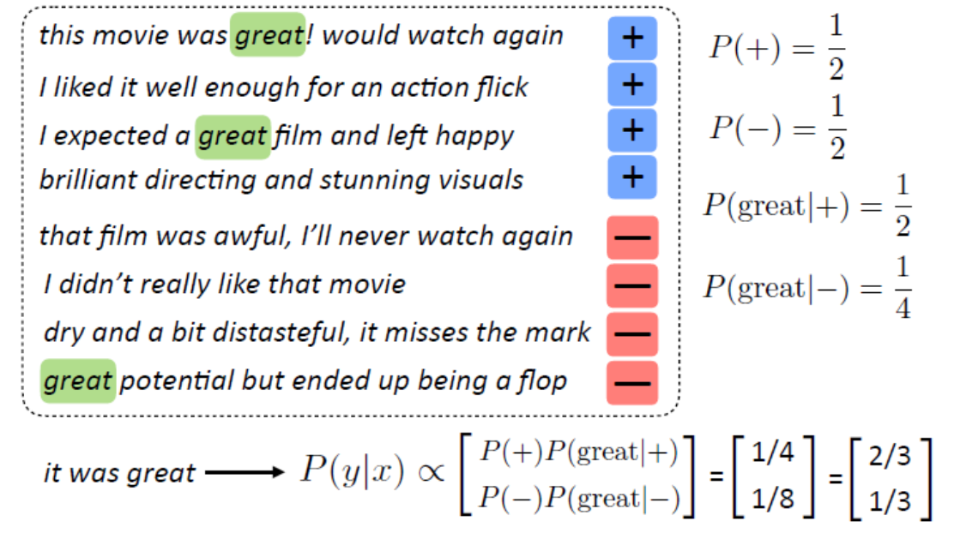
Another Example
[Greg Durrett]

Slide 23
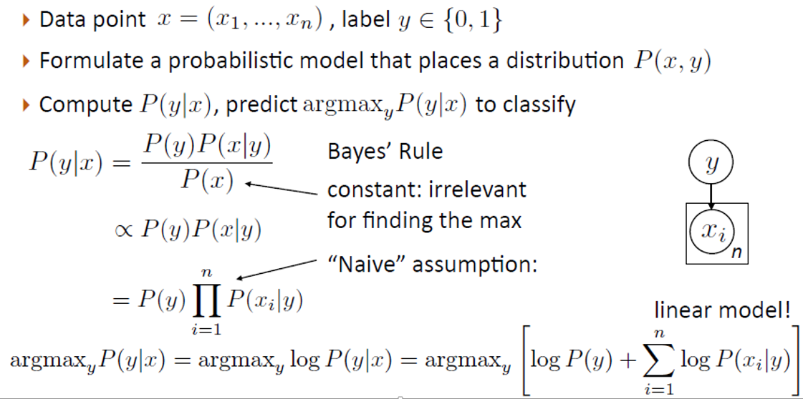
Summary (1)
[Greg Durrett]

Slide 24
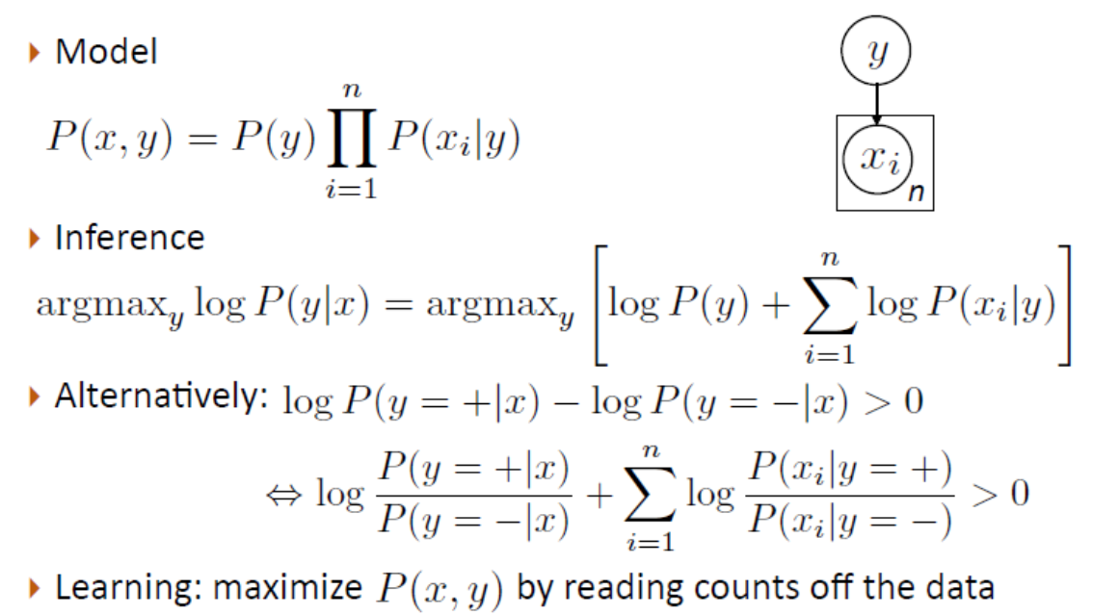
Summary (2)
[Greg Durrett]

Slide 25
Not So Naïve!
Very fast, low storage requirements
Robust to irrelevant features
Irrelevant features cancel each other without affecting results
Very good in domains with many equally important features
Decision trees suffer from fragmentation in such cases – especially if little data
Optimal if the independence assumptions hold
If assumed independence is correct, then it is the Bayes Optimal Classifier for problem
A good, dependable baseline for text classification
But other classifiers give better accuracy
[Jurafsky and Martin]

Slide 26
NLP

